Slide 1

Team 16: Sparky’s Finest

Slide 2
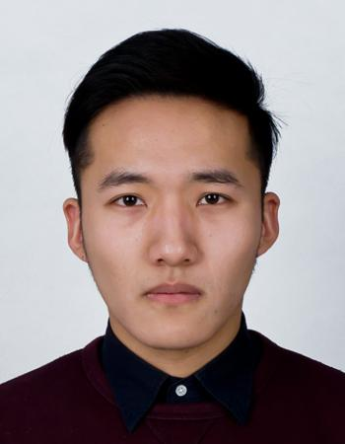
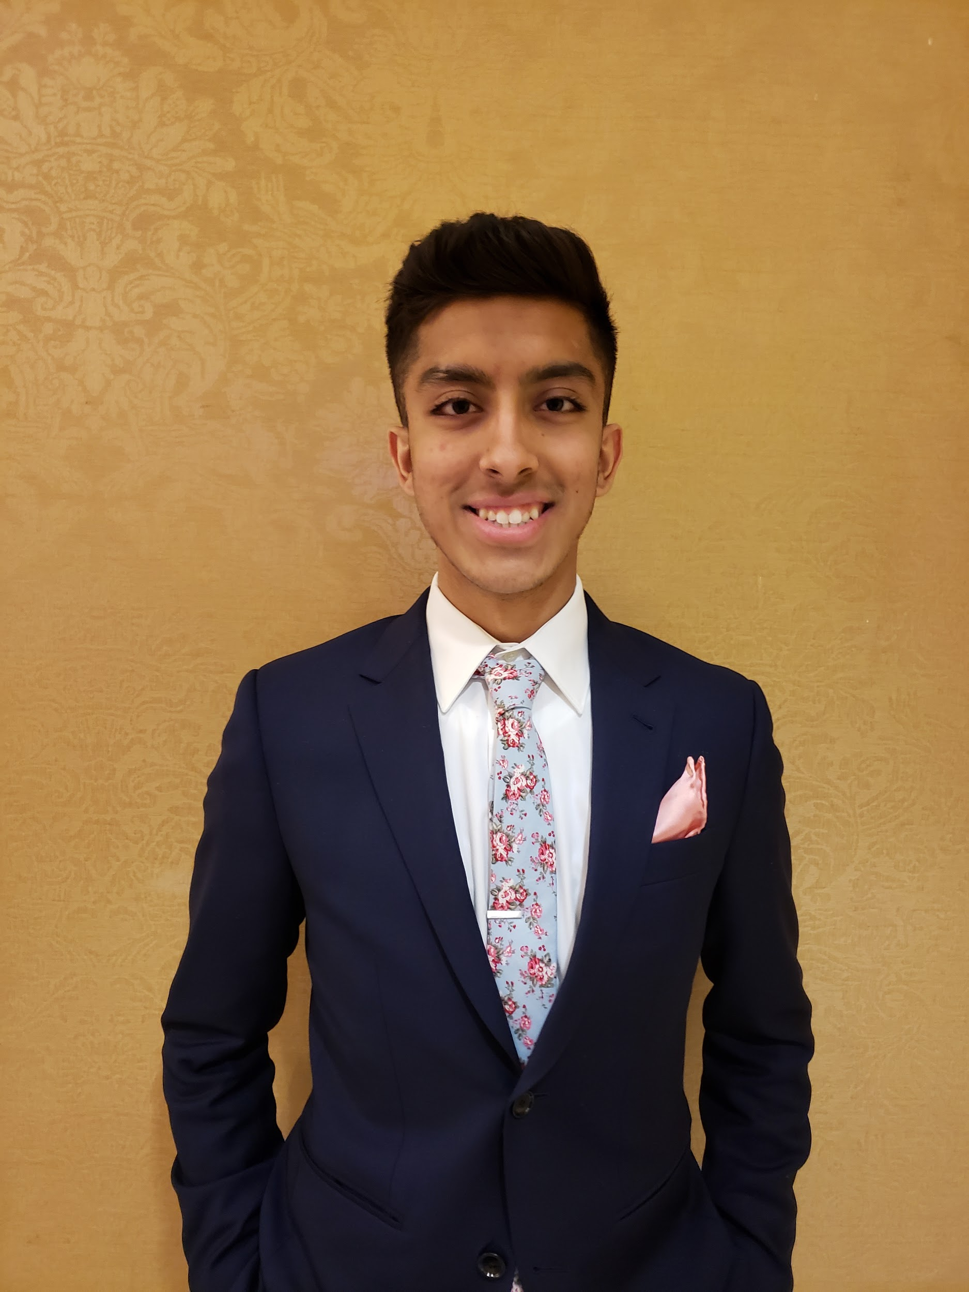
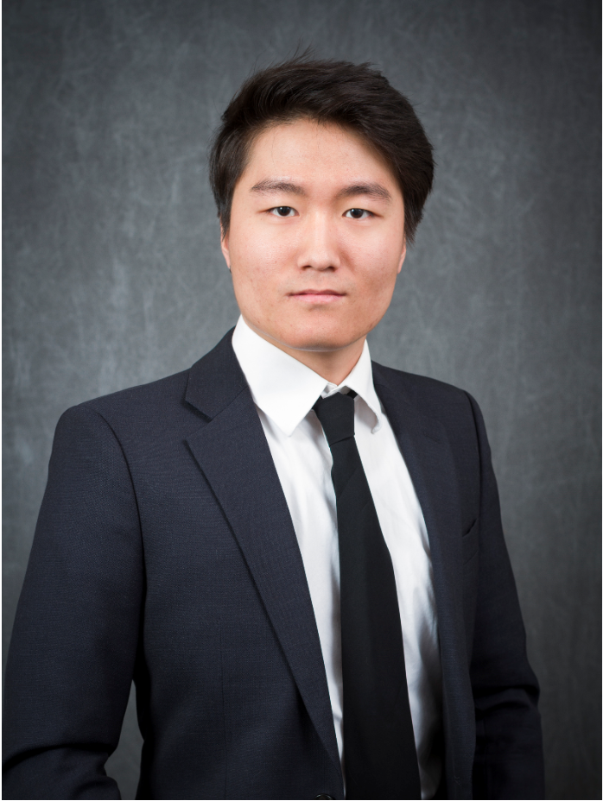
Jisung Woo
Omar
Notes:
I was born in Korea and moved to US at 2007
Corona del sol high school
CIS Major, hoping to graduate on december 2020
Performed at Super bowl halftime show held at AZ with Katy Perry
Played clarinet 8 years and made it to all state
Likes to play ping pong and hang out with friends
Two younger siblings, one is 19 years one is 8 years old

Slide 3
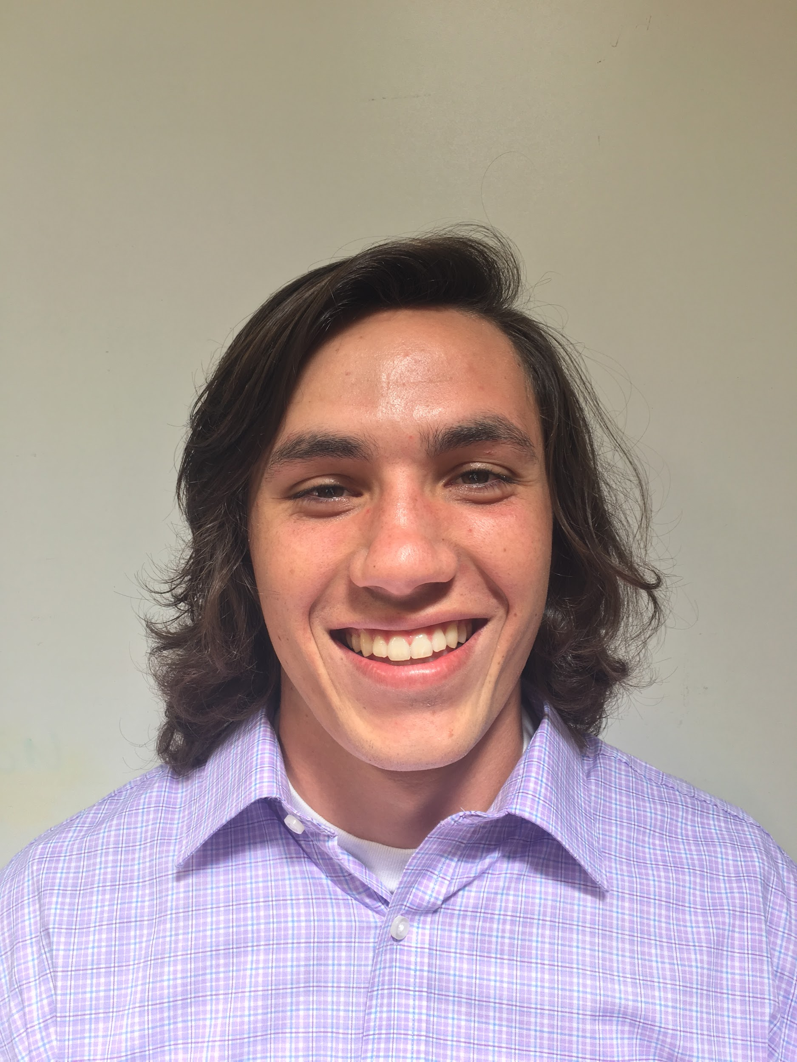
John Beguhl
Omar
Notes:
Likes to mountain bike
Played four years of football in high school
Also enjoys golfing and ultimate frisbee
Has seven siblings and 10 nieces and nephews
CIS and hoping to graduate in may of 2021
Has never been to hawaii
Favorite movie series is Rocky
Is currently training for a marathon
Jazz enthusiast during the winter

Slide 4
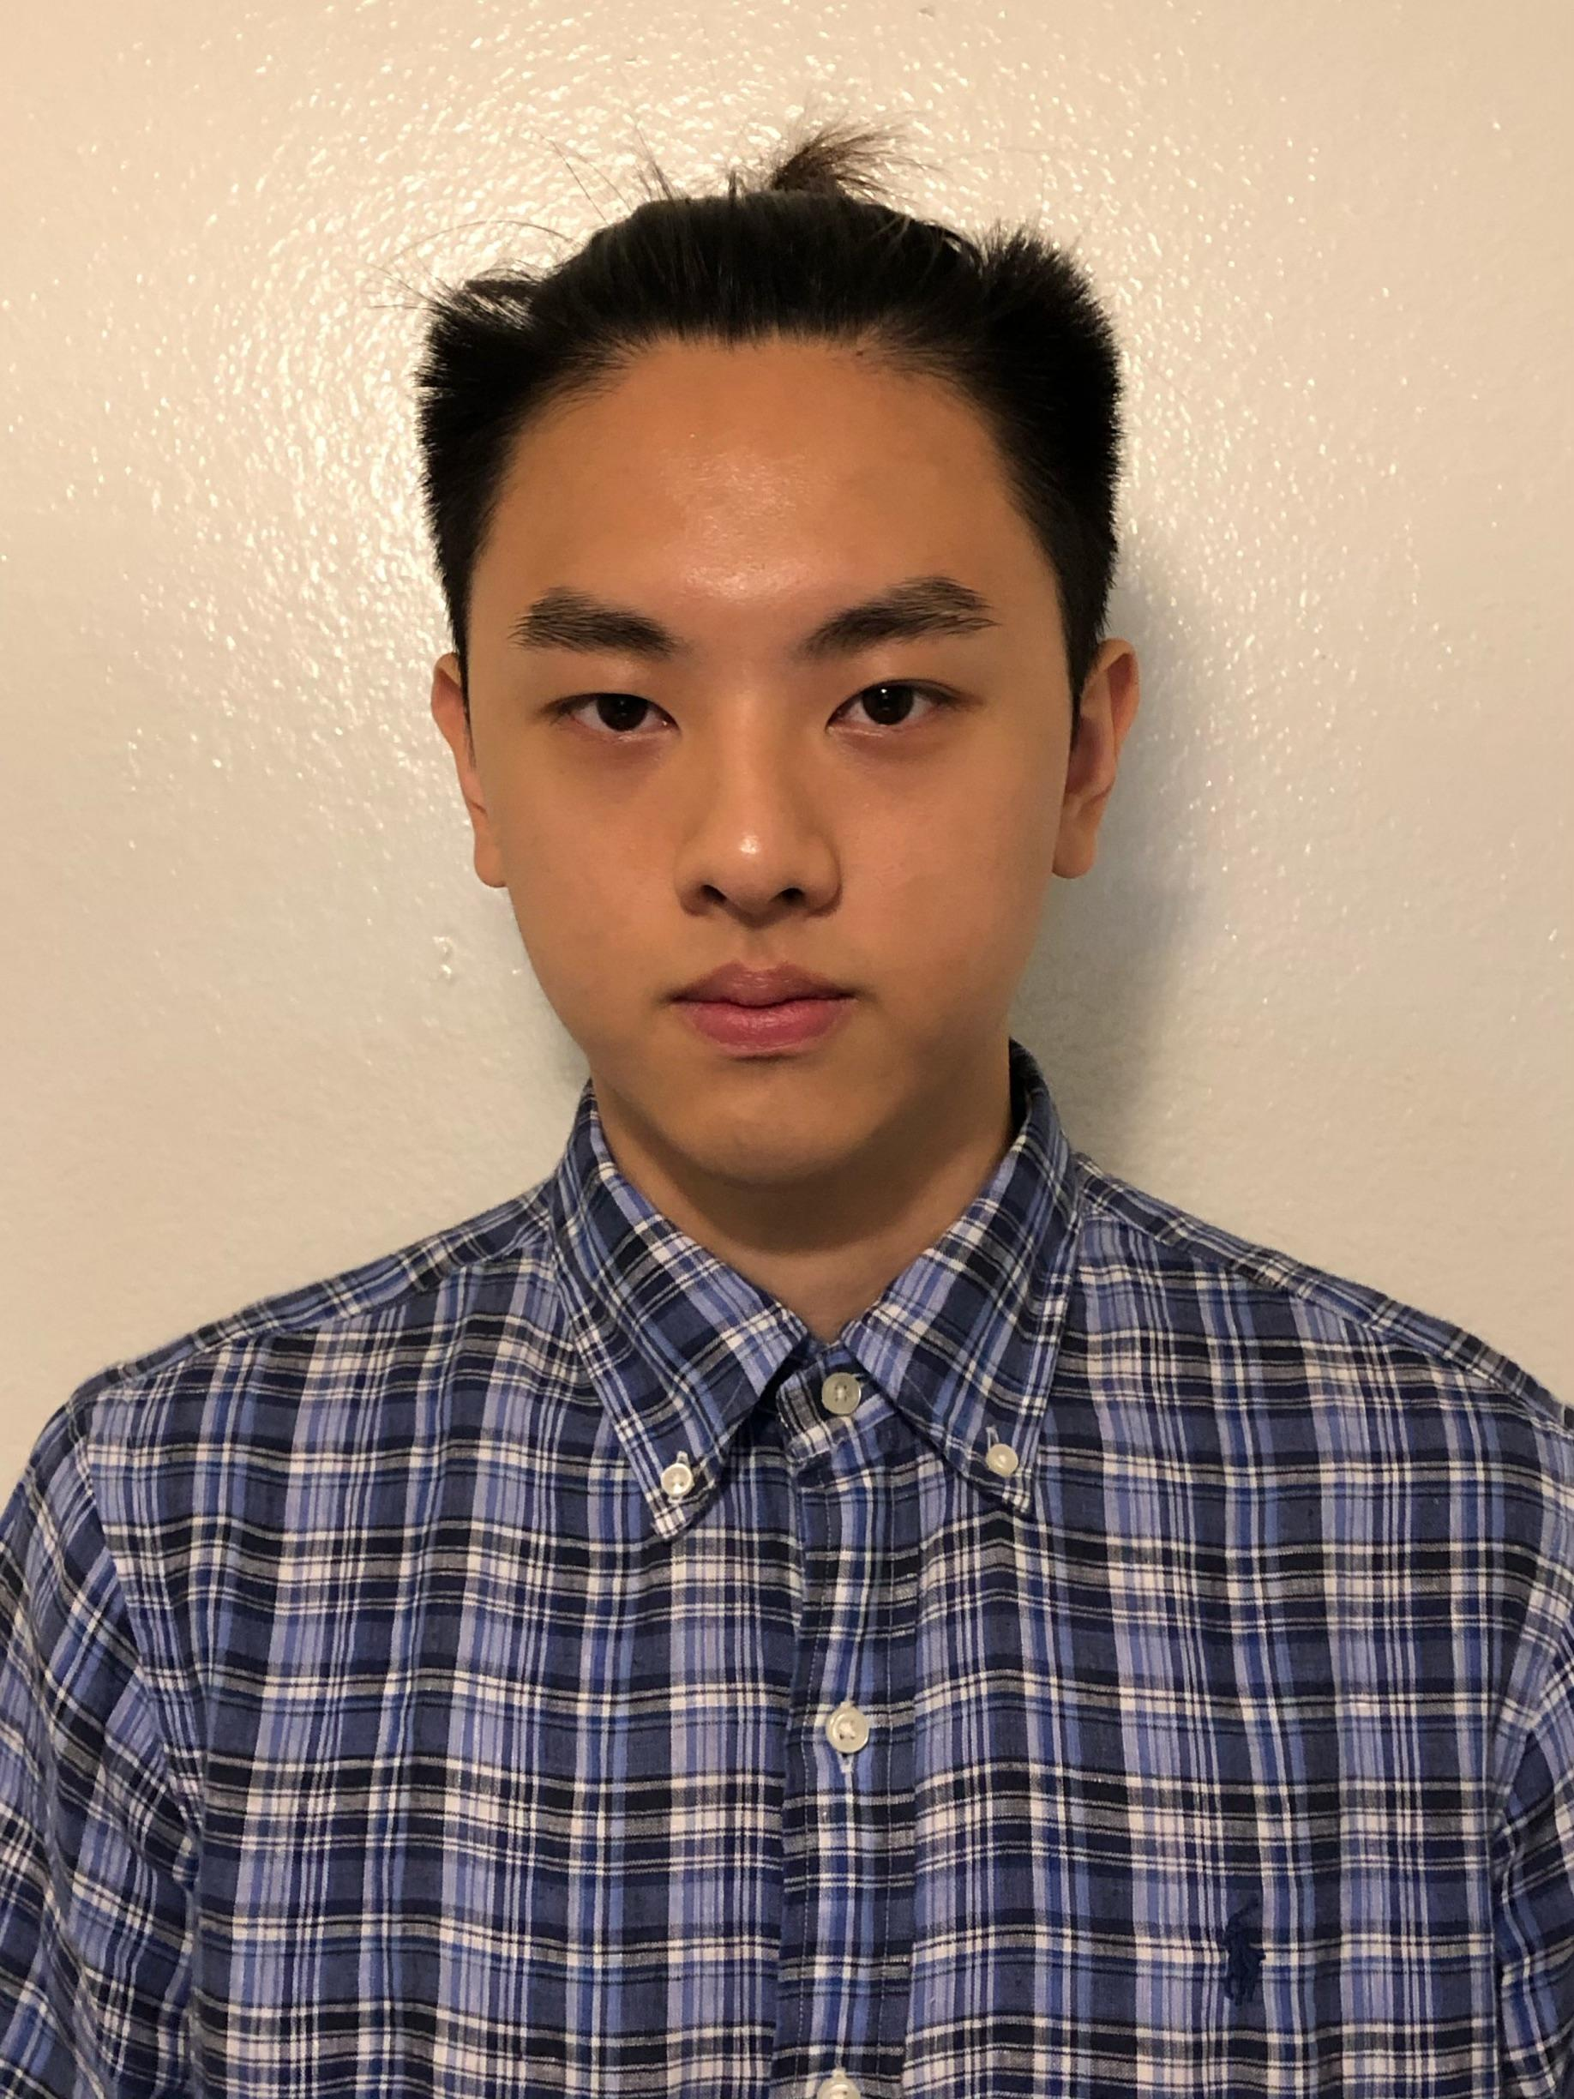
Kevin Yang
Omar
Notes:
Born and raised in Taiwan
3 siblings. half-brother, younger brother, and younger sister.
Play basketball in high school
Enjoy watching mma fight and boxing
CIS major expected to graduate in 2020
Played piano 14 years

Slide 5

In Memoriam
Omar

Slide 6
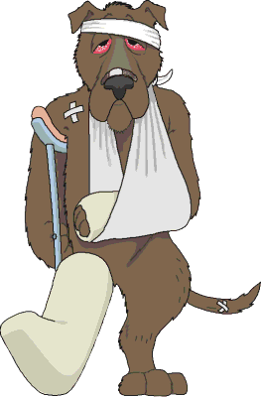
Scalawags Veterinary Clinic
Veterinary clinic owned by Dr. Randi Stedman.
Located in Henderson, NV.
Specializing in small animals.
Current information system is not computerized.
Tight budget!!!
Notes:
Jisong jp Story

Slide 7
What The Client Wants?
Keeping record up to date
Offer more services to their clients.
Transfer information from a file system to a database system.
Start transfer immediately.
Notes:
Kevin

Slide 8
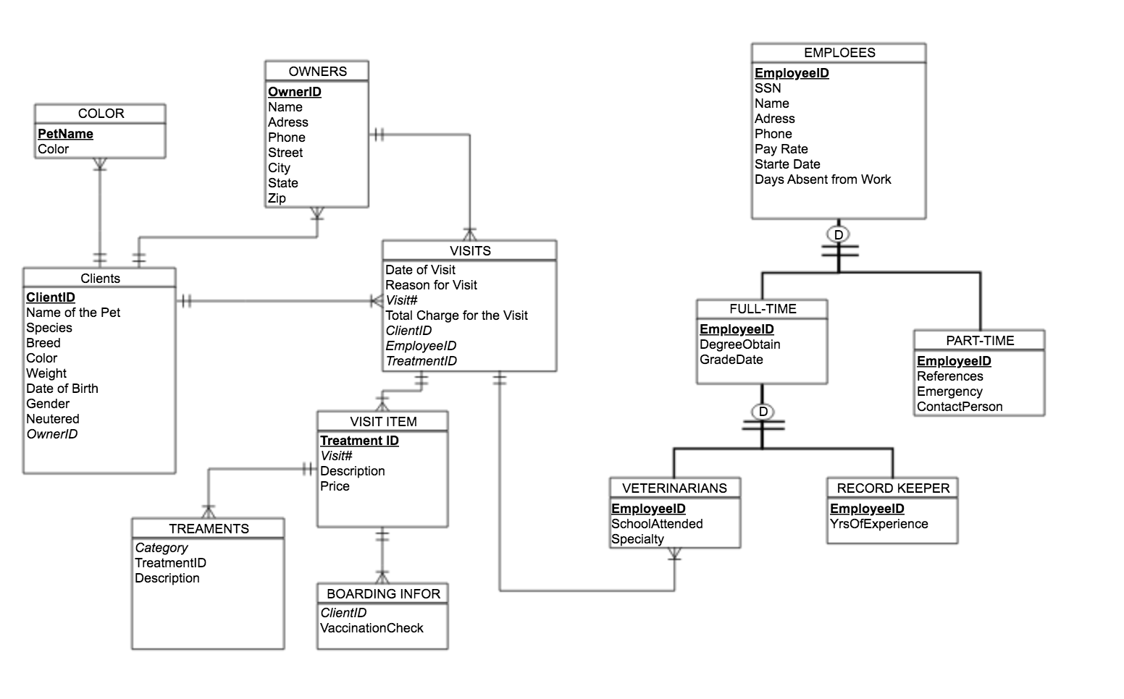
E/R Diagram before modification
Notes:
jisong

Slide 9
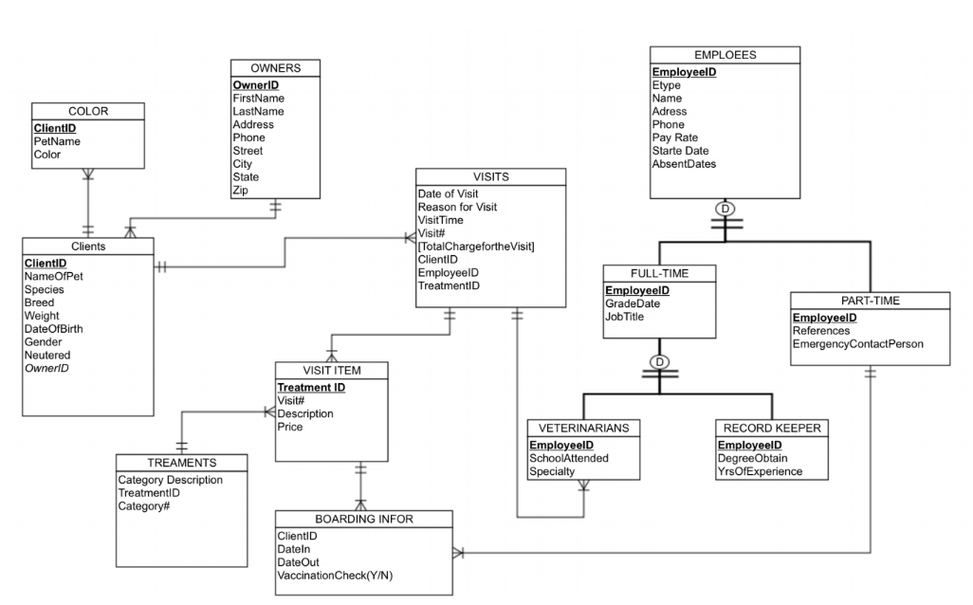
E/R Diagram after modification
Notes:
JP
Differences
Color
Primary key changed to ClientID
PetName added
Owners
Name changed to FirstName and LastName
Clients
Colors removed

Slide 10
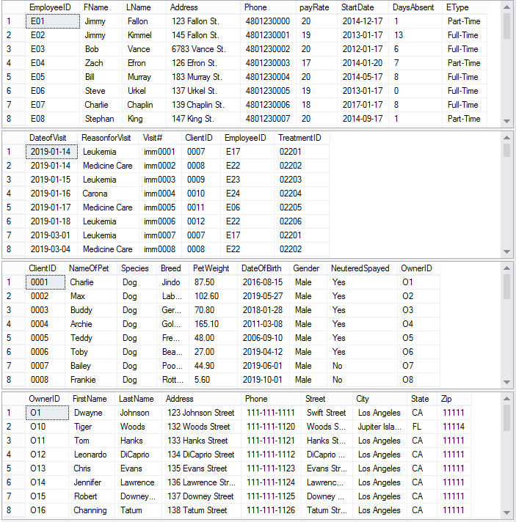
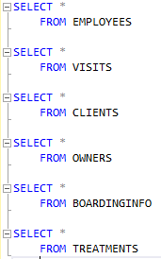
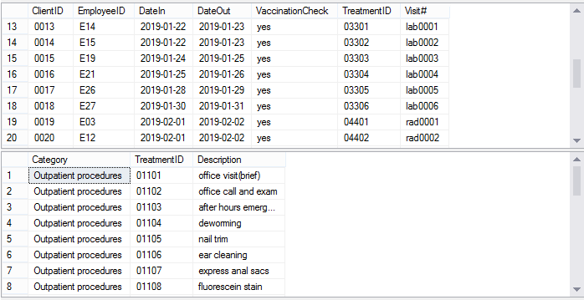
Sample Data Tables
Notes:
Kevin

Slide 11
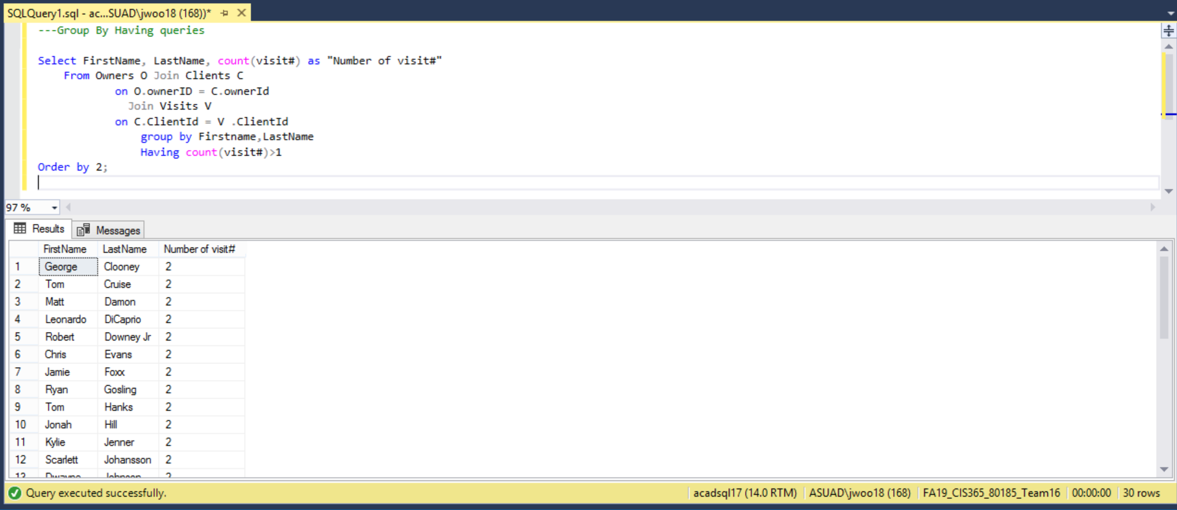
Advanced Query
Notes:
jisong

Slide 12
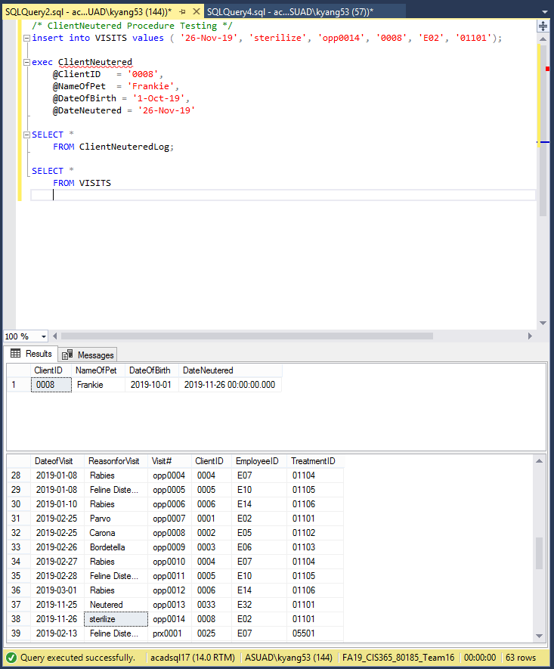
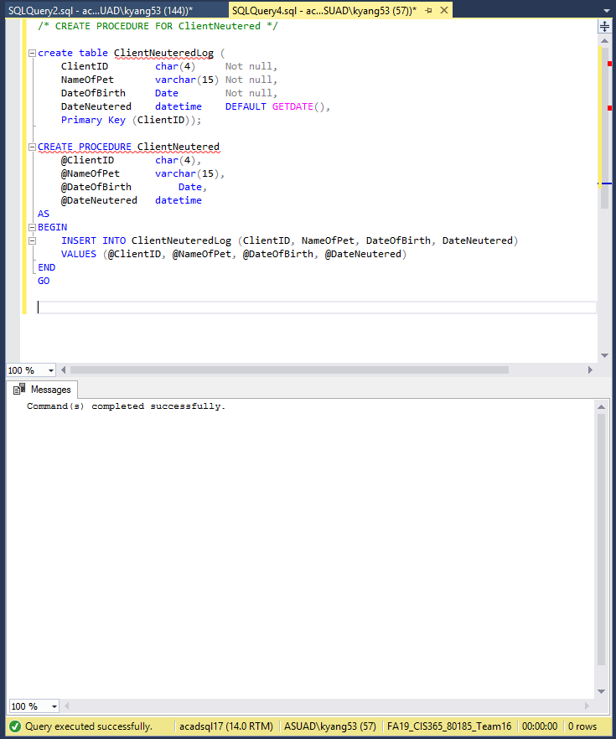
Notes:
Kevin
We thought that we needed a trigger to trip the procedure and add records to Visits, VisitItems and the Neuter Log

Slide 13
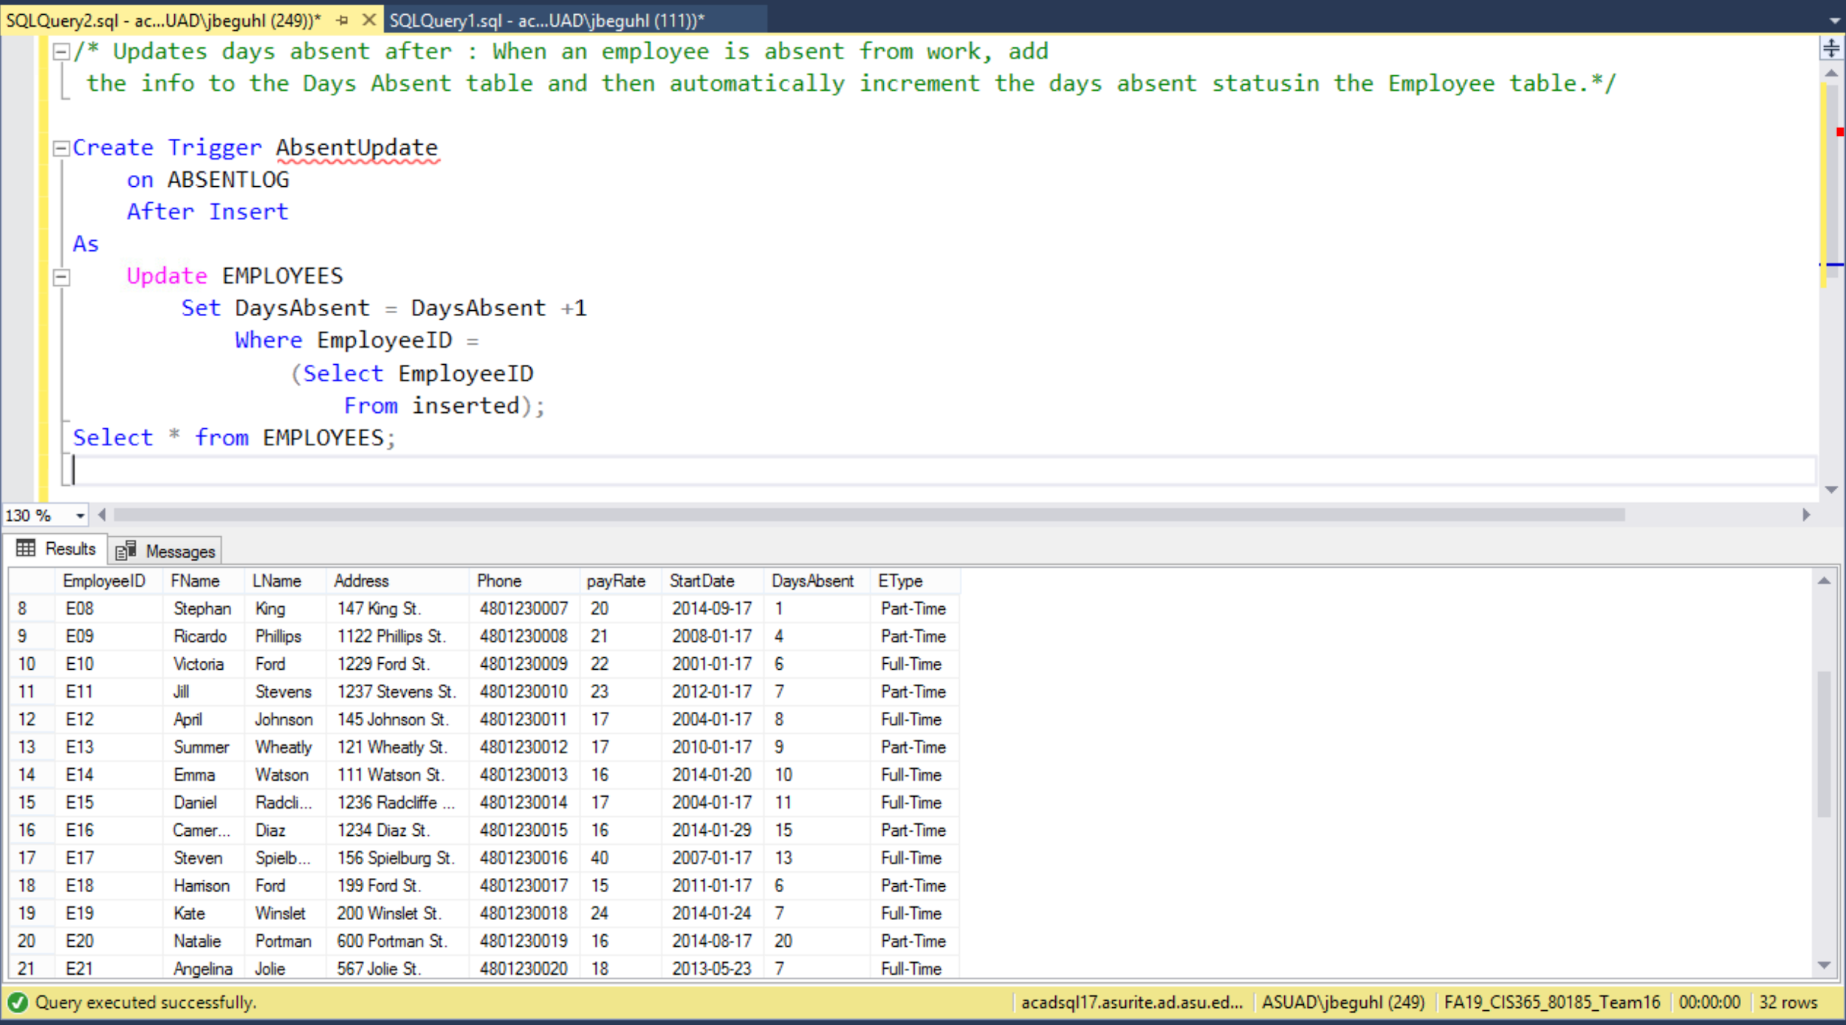
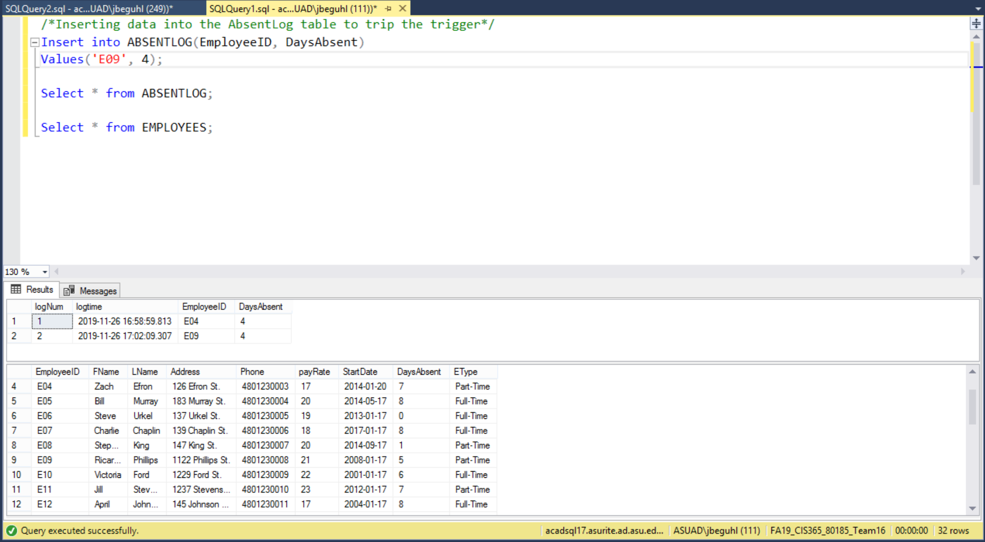
Notes:
JP

Slide 14
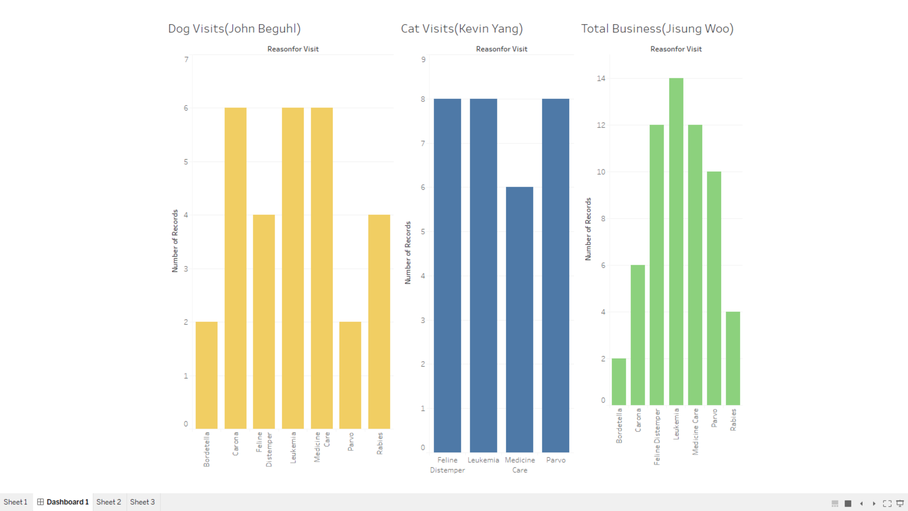
Visual Analytic Dashboard
Notes:
Jisong

Slide 15
Challenges
Losing half our members
Communication
Unfamiliarity with SQL
SQL Server
Group Cohesiveness
Inserting Data into our Group Database
Notes:
JP first 2 then Jisong then kevin
During first milestone we were not all on the same page and as a result we ended up submitting the it late.

Slide 16
Resolution
We had to work harder and meet more often since we had the same amount of work with only half the amount people
We did not have an actual meeting for Milestone 1 so we ended up submitting it late. After that we met more much more frequently.
We made it a priority to finish the homework before we started working on certain Milestones to ensure that we knew what we were doing.
We resolved to persistently close and open SQL Server until it cooperated with us.
To get to know each other we would just talk about random stuff for the first 10-15 minutes
We all had to get online when we were about to submit the milestone and found our inconsistencies .
Notes:
Same order as before

Slide 17
Lessons Learned
SQL can be very useful in Corporate America
Able to successfully react to unexpected situations (e.g. group members dropping)
Communication is a key to success
How to manage our time in a team setting
Organization is a key

Slide 18
Questions?

Slide 19
Thank You!

